Slide 1
1)NUMA (Non Uniform Memory Access)-Module 3-
2)Inclusion-Module 3-pages723-724
3)Synchronization – Module 4- pages694-..
4)Memory Consistency-Module4- pages708-..
5)Cache Coherence Protocols(Patterson)-Module4-pages 374…
Above page references are from Patterson 2nd Edition

Slide 2
NUMA
Non Uniform Memory Access
Is a method of configuring a cluster of microprocessor in a multiprocessing system so that they can share memory locally, improving performance and the ability of the system to be expanded.
(What is NUMA: SISD or SIMD or MISD or MIMD?)

Slide 3
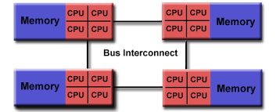

Slide 4
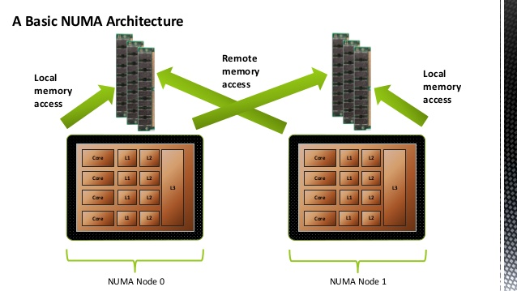

Slide 5
NUMA
is used in a symmetric multiprocessing ( SMP ) system.
An SMP system is a multiple processors system
  "tightly-coupled," i.e"share everything" system, access each other's memory over a common bus or "interconnect" path.
  working under a single operating system

Slide 6
Limitation of SMP
(symmetric multiprocessing )
is that as microprocessors are added, the shared bus or data path get overloaded and becomes a performance bottleneck
NUMA adds an intermediate level of memory shared among a few microprocessors so that all data accesses don't have to travel on the main bus.

Slide 7
NUMA
cluster typically consists of four microprocessors (for example, four Pentium microprocessors)
interconnected on a local bus (for example, a Peripheral Component Interconnect bus) to a shared memory (called an "L3 cache ") on a single motherboard (it could also probably be referred to as a card ).

Slide 9
NUMA contd..
This unit can be added to similar units to form a symmetric multiprocessing system(SMP)
in which a common SMP bus interconnects all of the clusters.
  Such a system typically contains from 16 to 256 microprocessors. To an application program running in an SMP system, all the individual processor memories look like a single memory.

Slide 10
NUMA(Non-Uniform Memory Access)
Each of these clusters is viewed by NUMA as a "node" in the interconnection network.
NUMA maintains a hierarchical view of the data on all the nodes.

Slide 11
NUMA
SCI coordinates Cache Coherence
Data is moved on the bus between the clusters of a NUMA SMP(Symmetric Multiprocessing) system
  using scalable coherent interface (SCI) technology
SCI coordinates "cache coherence" or consistency across the nodes of the multiple clusters.

Slide 12
Searching sequence in Memory
When a processor looks for data at a certain memory address,
  it first looks in the L1 cache line on the microprocessor itself,
  then on a somewhat larger L2 cache chip nearby,
  then on a third level L3 of cache and memory that the NUMA configuration provides
  At the end seeking the data in the "remote memory" located near the other microprocessors

Slide 13
Multilevel Inclusion
Every level of cache hierarchy is a subset of the level further away from the processor
  Then we can use the multilevel structure to reduce the contention between coherence traffic and processor traffic
    This is possible when block size is same at all levels.
  To maintain inclusion with multiple block size , check higher level of hierarchy, when replacement is done at the lower level to ensure that any word replaced at lower level is invalidated in the higher cache

Slide 15
Cache Coherence Problem
• In multi-processor systems,
data can reside in multiple levels of cache, as well as in main memory.
This can cause problems if all CPUs don't see the same value for a given memory location.

Slide 16
Cache Coherence contd..
• To ensure coherence and consistency, you want all
caches to see all memory accesses in program order.
• A memory system is coherent
if it sees memory accesses to a single location in order
– A read to P following a write to P returns P, regardless of which processor reads/writes
  Writes are serialized so each processor sees them in the same order

Slide 17
Cache Consistency
• A memory system is consistent
if it sees memory accesses to different locations in order

Slide 18
Examples of Oder Maintenance
First, a write does not
complete (and allow the next write to occur) until all processors have seen the effect of that write.
Second, the processor does not change the order of any write with respect to any other memory access. These two conditions mean that if a
processor writes location A followed by location B, any processor that sees the new value of B
must also see the new value of A.

Slide 19
Syncronization
To maintain the order of read-write (Serialization of critical sections)
  Done by hardware spinlocks
  software queuelocks or semaphore type of things from programmers point of view.
To maintain order of memory access among processors
  Fences are set to ensure no read or write is moved across the fences
    Used to ensure writes /reads of a portion have completed

Slide 20
Cache Coherence
Two classes of protocols to ensure
cache coherence
● Directory based: a central location (directory) contains the sharing status of all blocks in all caches
(more scalable).
● Snooping: each cache listens on a shared bus for events regarding cache blocks (less scalable).

Slide 21
Snooping Protocol
Two ways to ensure cache coherence
● Write invalidate protocol: on a write,
broadcast a block invalidation message
on the bus so everyone knows their
local copy is dirty.
● Write update protocol: on a write, the
value is broadcast on the bus and
everyone updates their local copy.

Slide 22
Snooping Protocol
• We use write-invalidate + write-back caches
• Track block sharing status
  When writing to a shared block, must first acquire the bus to broadcast the invalidation
• Finding data on a read
– most recent version of the block might be in
another cache (with write-back caches)
    all caches must monitor the address line for dirty
blocks they might have and update the status of
those blocks so they don't use those values

Slide 23
Processor activity | Bus activity | Contents of CPU A's cache | Contents of CPU B's cache | Contents of memory location X
 |  |  |  | 0
CPU A reads X | Cache miss for X | 0 |  | 0
CPU B reads X | Cache miss for X | 0 | 0 | 0
CPU A writes a 1 to X | Invalidation for X | 1 |  | 0
CPU B reads X | Cache miss for X | 1 | 1 | 1
An example of an invalidation protocol working on a snooping bus for a
single cache block (X) with write-back caches

Slide 24
Snooping Protocols 1
Write Invalidate
  CPU wanting to write to an address, grabs a bus cycle and sends a ‘write invalidate’ message
  All snooping caches invalidate their copy of appropriate cache line
  CPU writes to its cached copy (assume for now that it also writes through to memory)
  Any shared read in other CPUs will now miss in cache and re-fetch new data.

Slide 25
Snooping Protocols 2
(not used since too many updates required)
Write Update
  CPU wanting to write grabs bus cycle and broadcasts new data as it updates its own copy
  All snooping caches update their copy
Note that in both schemes, problem of simultaneous writes is taken care of by bus arbitration - only one CPU can use the bus at any one time.

Slide 26
Update or Invalidate?
Due to both spatial and temporal locality, previous cases occur often.
Bus bandwidth is a precious commodity in shared memory multi-processors
Experience has shown that invalidate protocols use significantly less bandwidth.
Will consider implementation details only of invalidate.

Slide 27
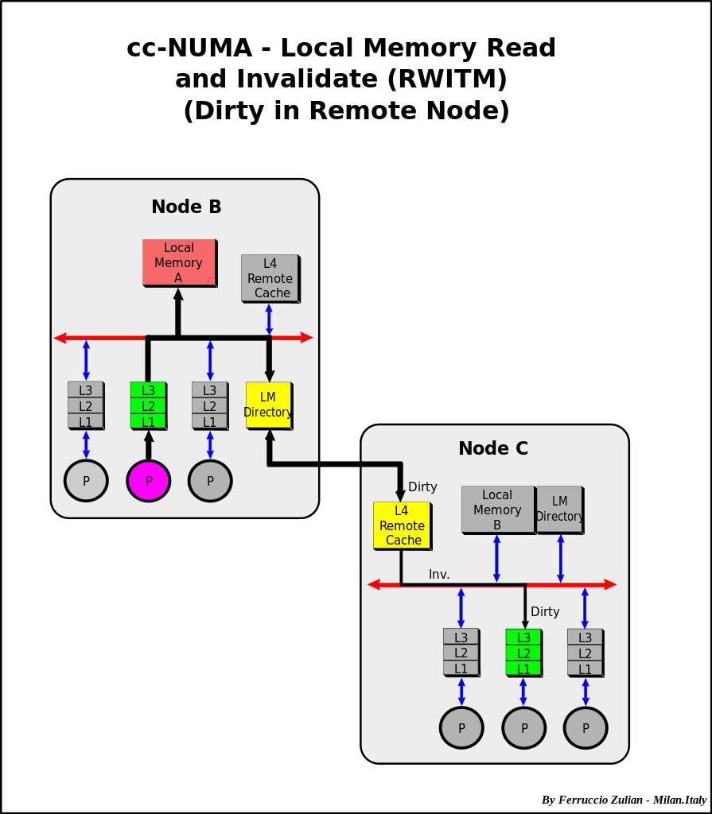

Slide 28
Software Cache Solution
Relies on operating system and compiler
Compiler based coherence mechanism performs an analysis on the code to determine which data items become unsafe for caching and mark them
Operating system prevents any non cacheable item being cached
Advantage of Software solution: overhead of detecting potential problems is transferred from run time to compile time

Slide 29
NUMA Applications
SMP and NUMA systems
used for applications such as data mining and decision support system in which processing can be parceled out to a number of processors that collectively work on a common database
( Sequent, Data General, and NCR are among companies that produce NUMA SMP systems)

Slide 31
Causes of High Miss Rates
the three Cs model sorts all misses into three simple categories:
• Compulsory—The very first access to a block cannot be in the cache, so the
block must be brought into the cache. Compulsory misses are those that occur even if you had an infinite cache.
• Capacity—If the cache cannot contain all the blocks needed during execution
of a program, capacity misses (in addition to compulsory misses) will occur
because of blocks being discarded and later retrieved.
• Conflict—If the block placement strategy is not fully associative, conflict
misses (in addition to compulsory and capacity misses) will occur because a
. block may be discarded and later retrieved if conflicting blocks map to its set

